Slide 1
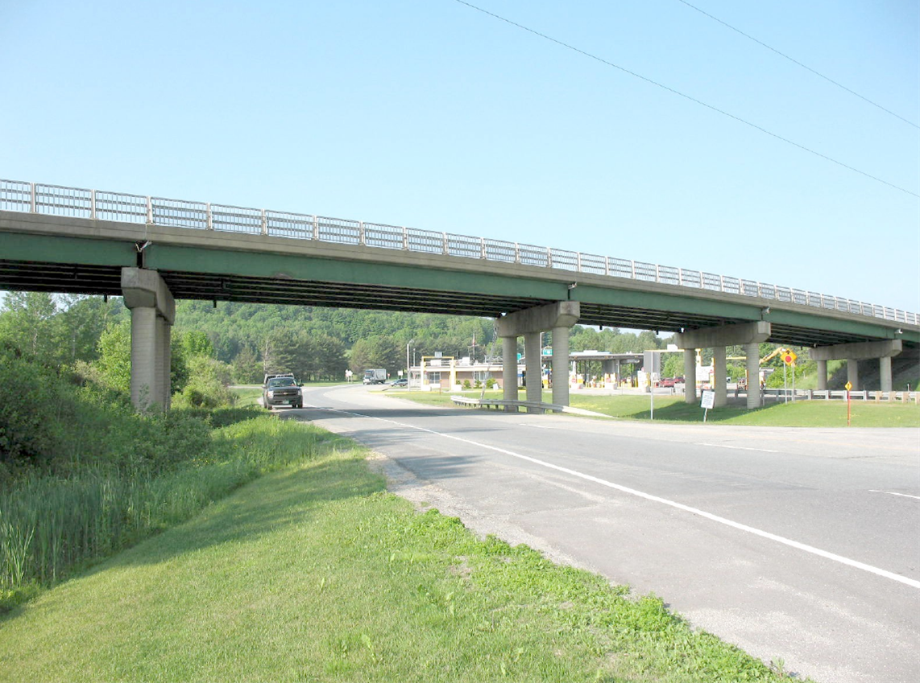

  Derby IM 091-3(49)
  Public Information Meeting Traffic Control
  Caswell Avenue (TH 1)- Bridge # 114 over I91
  March 14, 2018

Slide 2
Purpose of Meeting
Provide overview of bridge replacement project
Discuss Caswell Bridge Closure
Detours
Tentative construction schedule and timelines
Provide an opportunity to ask questions and voice concerns

Slide 3
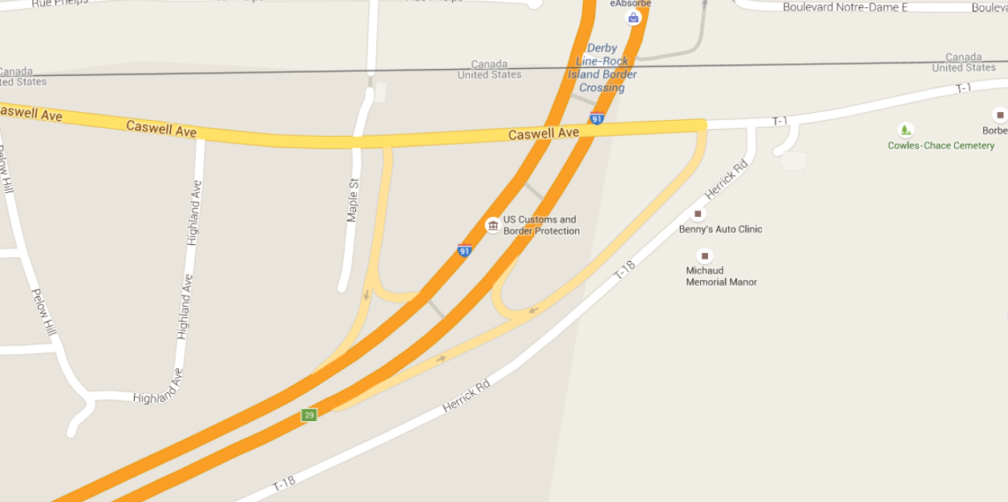
Location
To Derby Line Village
To Holland
Border Crossing Station
Bridge #114
Project Location
North
Notes:
North arrow, add label border crossing station add to Holland arrow right to derby line village left, label 91S, add Canadian border

Slide 4
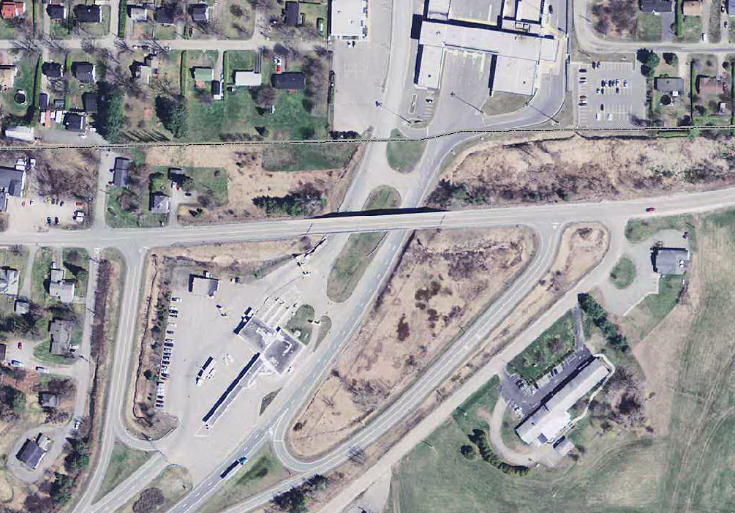
Bridge #114
Project Location

Slide 5
Existing Conditions
Substandard bridge railing
Damages and spalling on the curb and sidewalk
Significant deck cracking
Paint is peeling from girders
Spalling of south side fascia and piers, rebar exposed

Slide 6
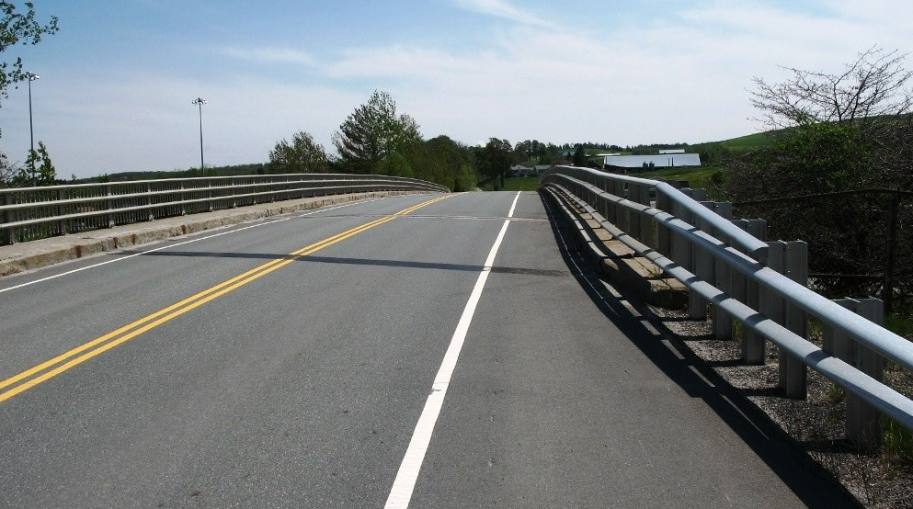
Existing Bridge Information
Roadway classification: Rural Major Collector (Class 1 State Highway)
Bridge type: 5 Span Rolled Beam, Concrete Deck with Pavement
Constructed: 1962
Ownership: Town of Derby

Slide 7
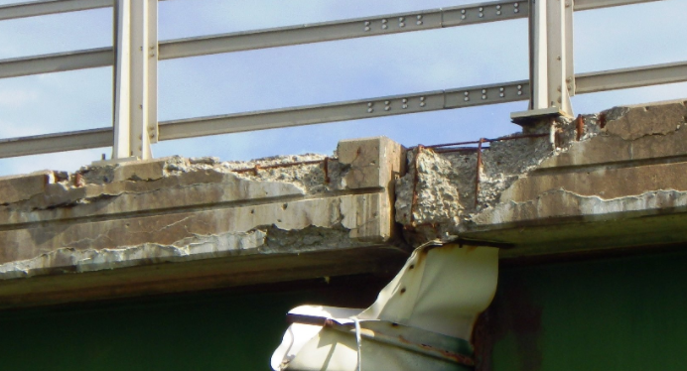
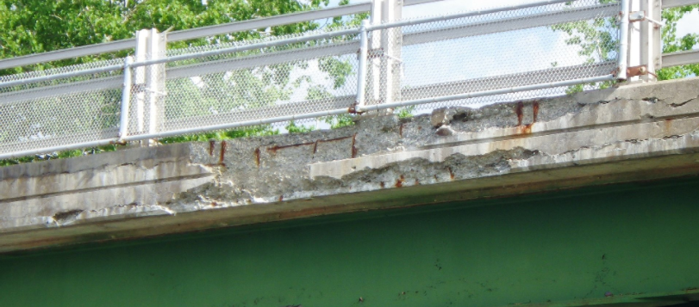
Fascia
Concrete
Failure

Slide 8
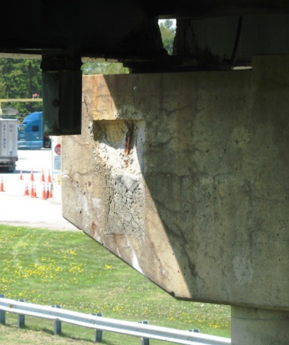
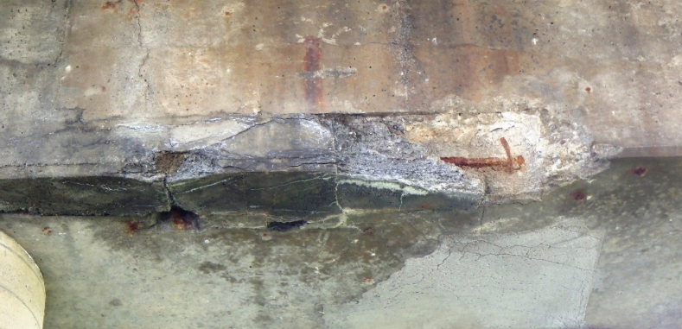
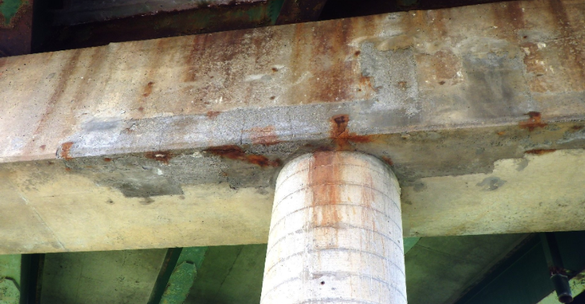
Pier Spalling

Slide 9
New Bridge
Complete bridge replacement

Slide 10
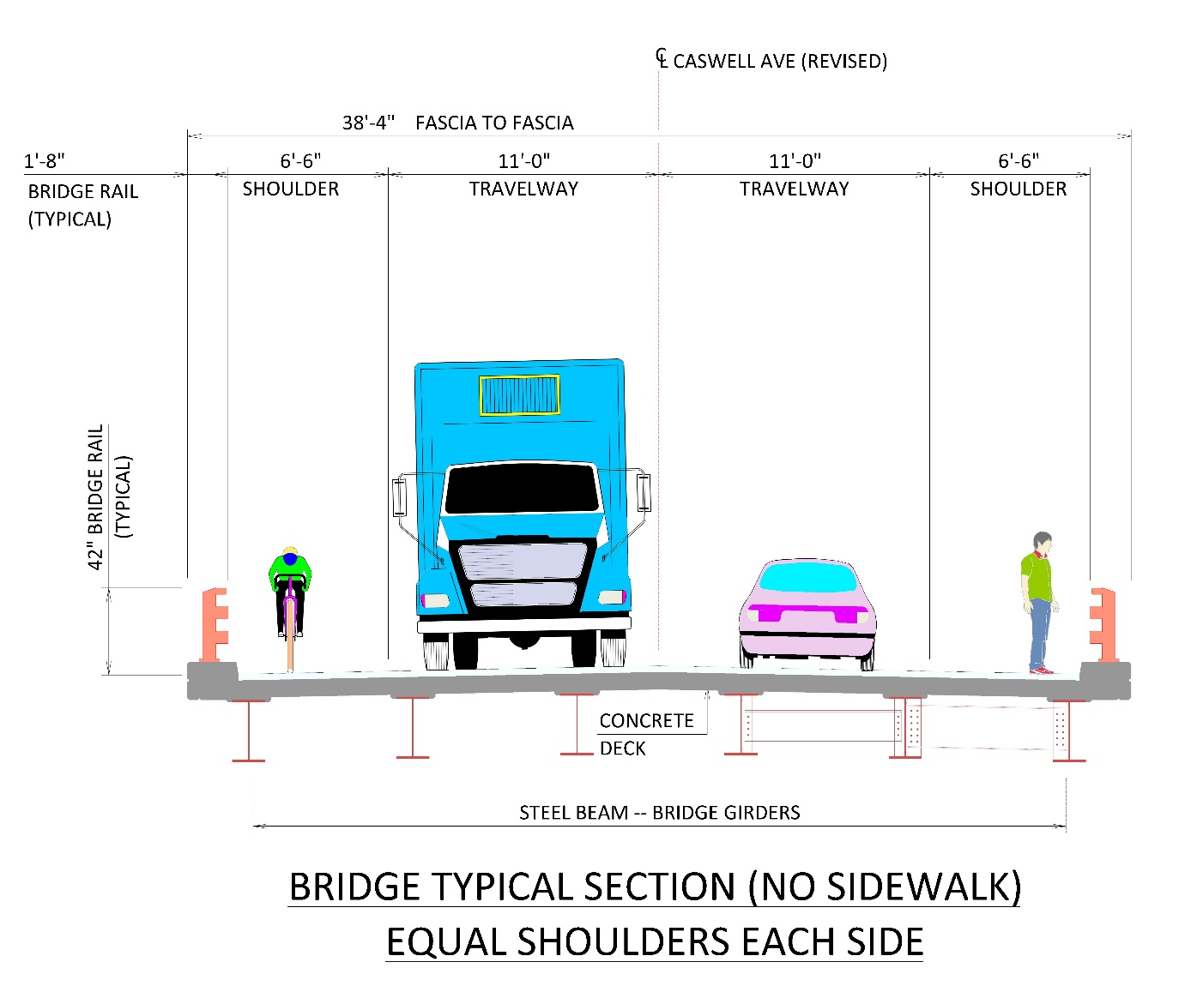
Typical Sections

Slide 11
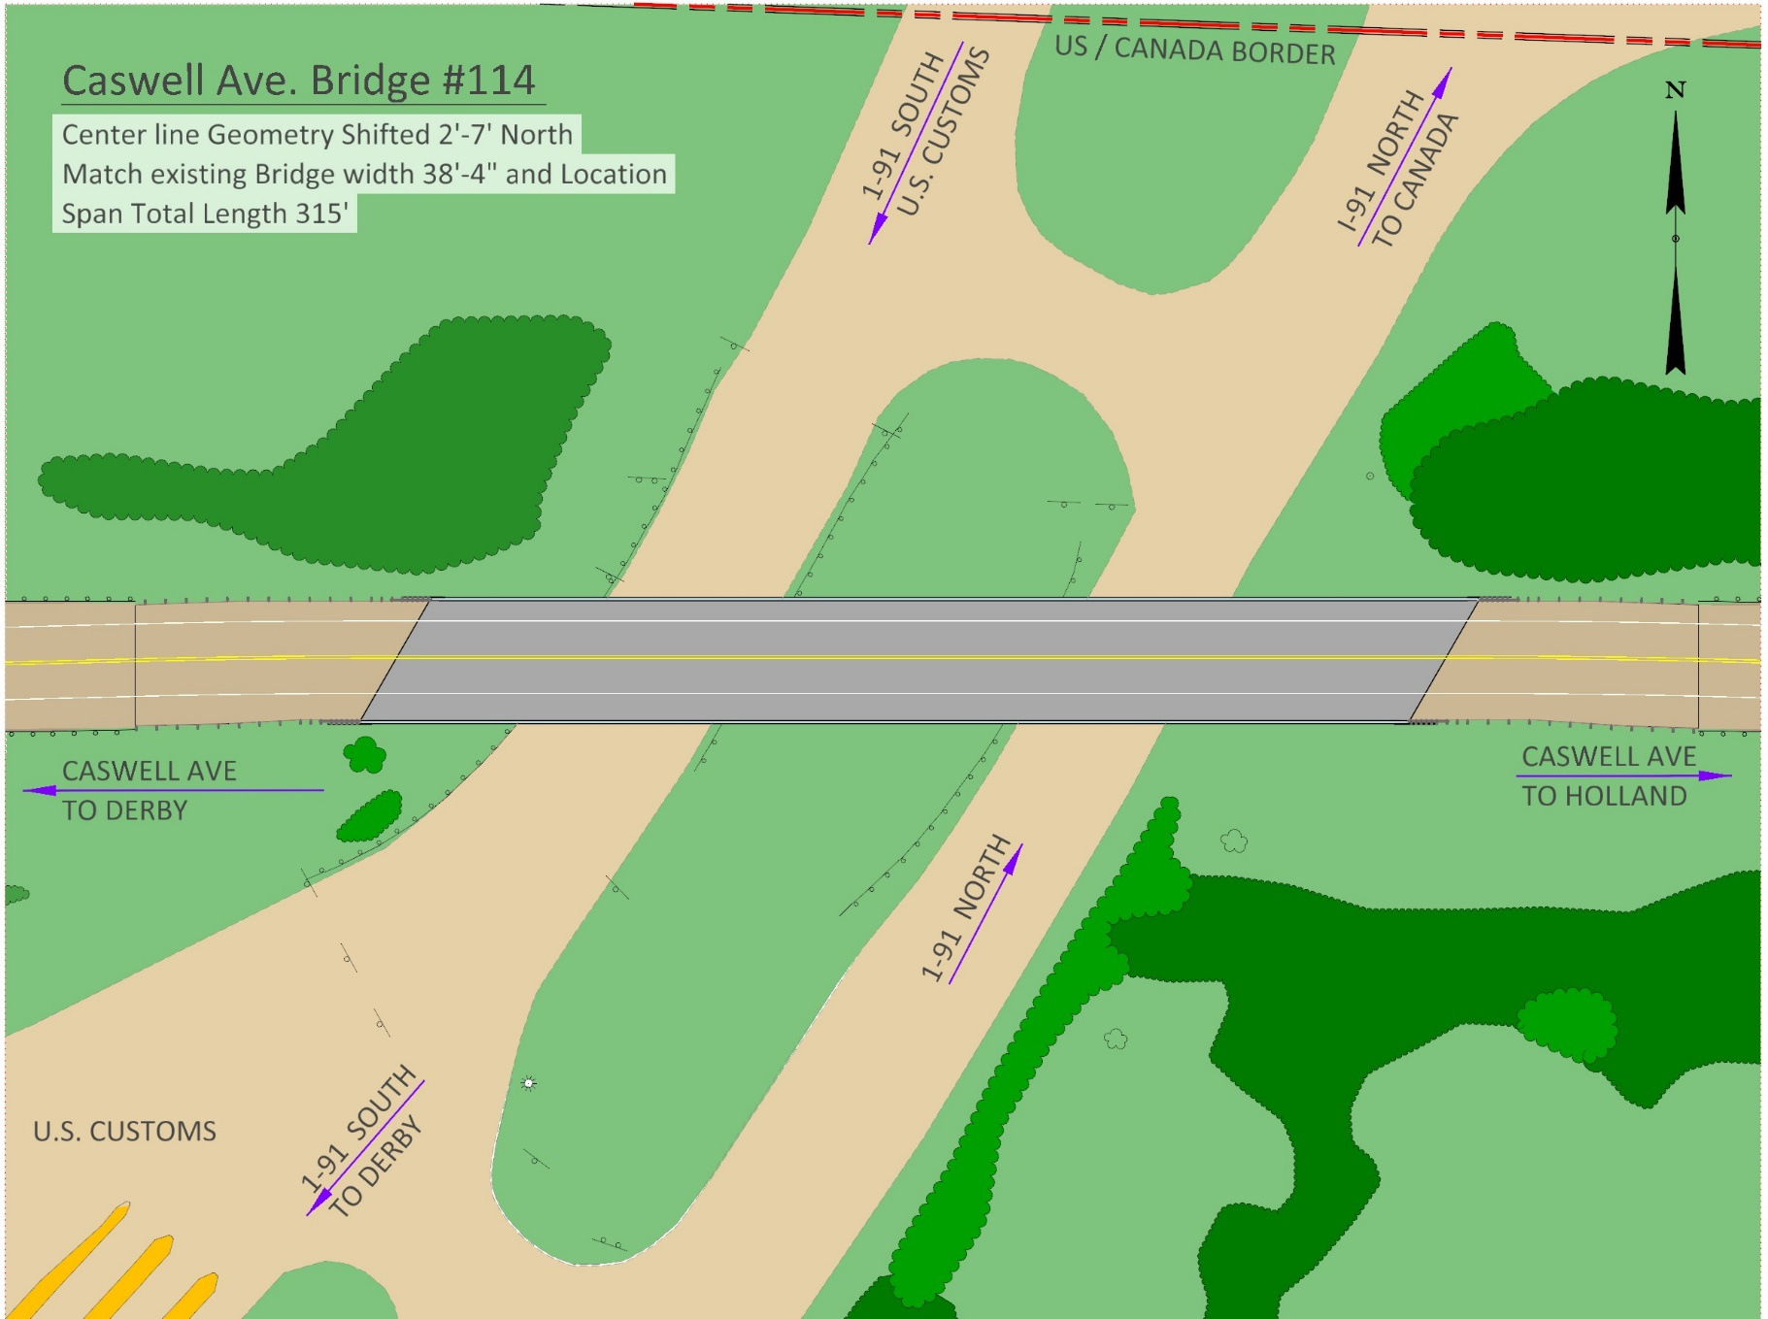

Plan View

Slide 12
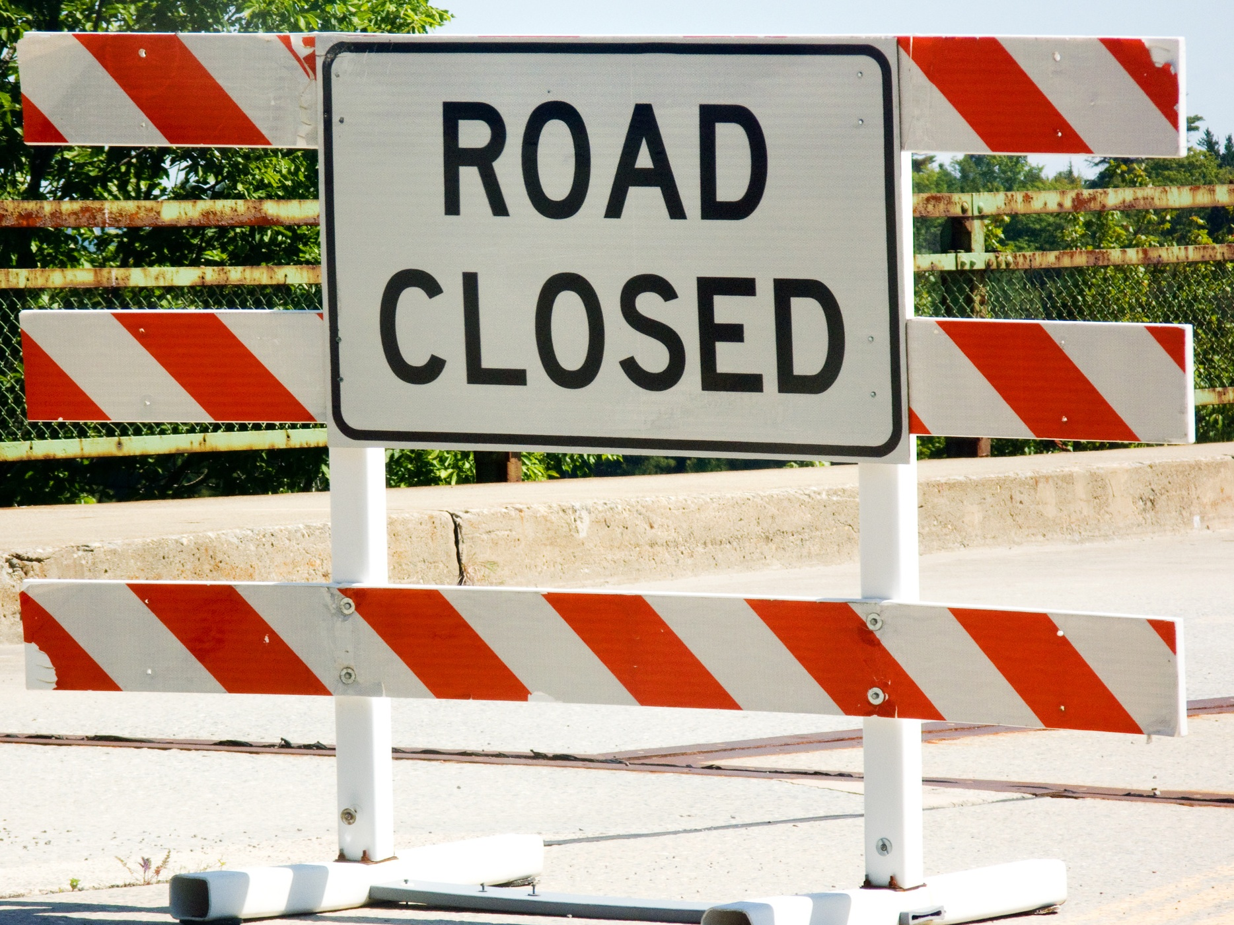
Notes:
-This is from the intersection of VT25b and Main Street (US 5) to the intersection of Main Street (US 5) and VT 25. Does not include what would be total detour if starting on one side of the bridge and driving detour all the way to the other side of the bridge.

Slide 13

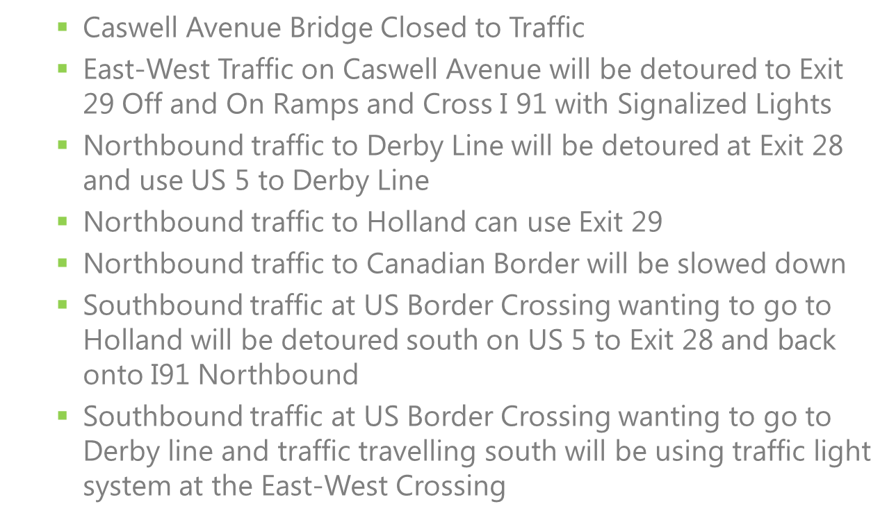

Slide 14
Bridge Closure
Notes:
Lengthy detour, temporary bridge is not an option

Slide 15
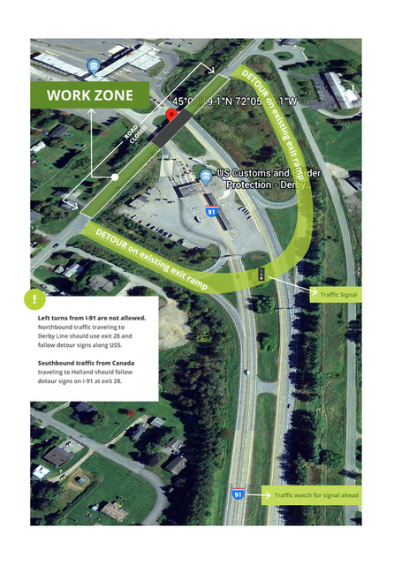

Slide 16
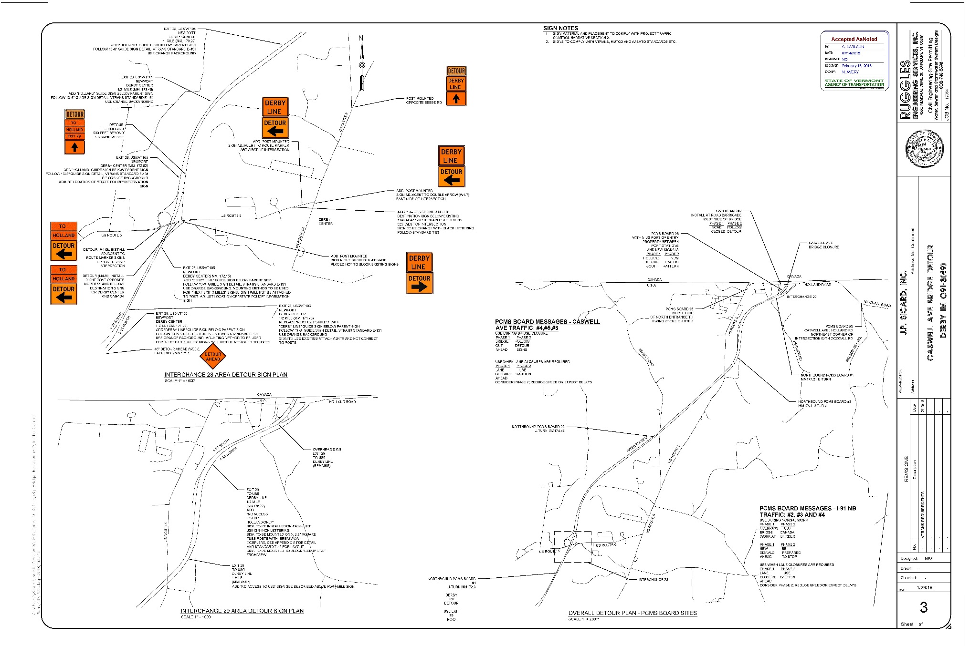
Derby Line
Signed Detour

Slide 17
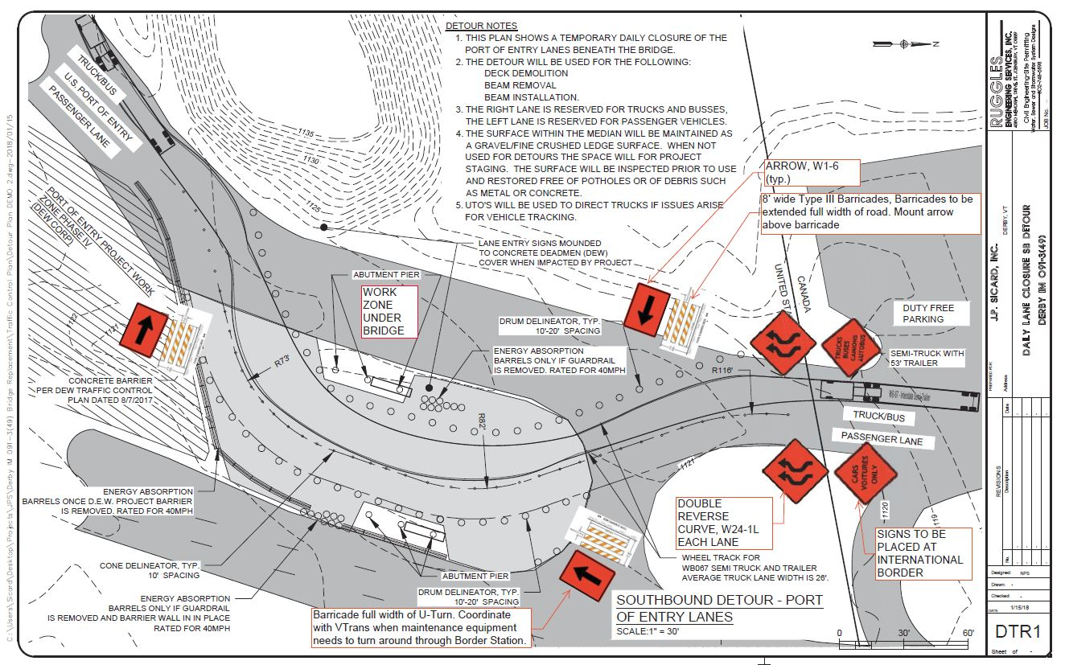
Traffic Control Under the Bridge
During removal of existing bridge
Installing New Structural Steel

Slide 18
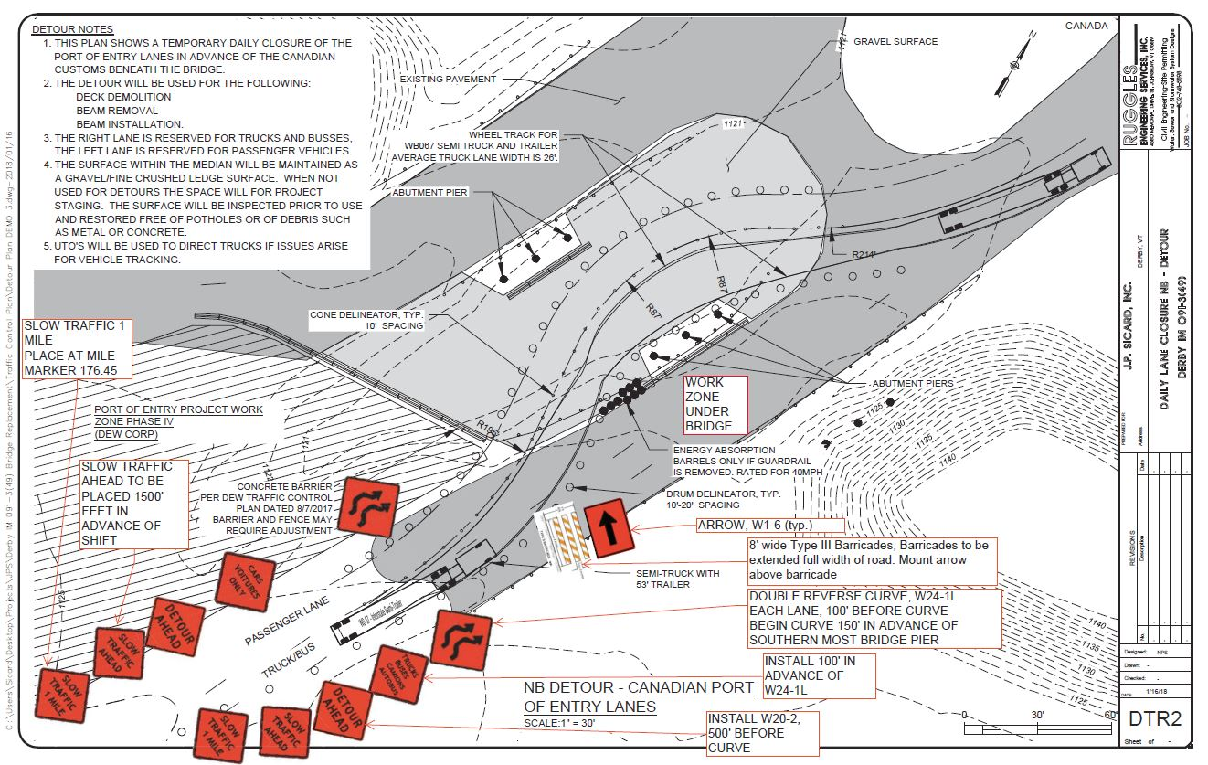
Traffic Control Under the Bridge

Slide 19
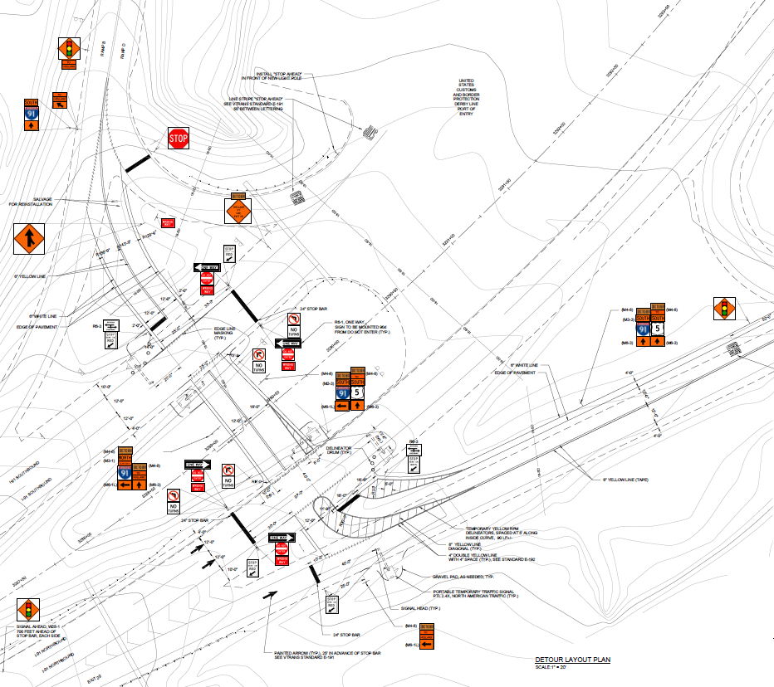
On-Site Traffic Control

Slide 20
Construction Schedule and Timeline
  Bridge will be closed to traffic the first week of April
  Bridge Demolition – April 4th thru April 25th
  Structural Steel – July 9th – July 13th
  Bridge Open to Traffic – October 2nd
  Project Completion – Oct 12th

Slide 21
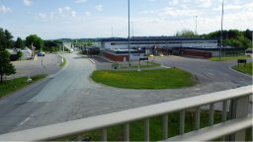
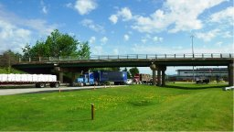
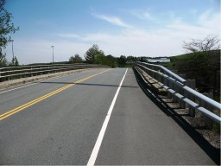
Questions?

